Slide 1

PRESENTATION SKILLS

Slide 2

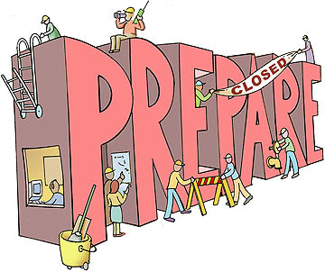

Steps for Presentation
Planning a Presentation
Preparing for a presentation
Making a Presentation
This Photo by Unknown Author is licensed under CC BY-SA-NC

Slide 3
Planning a Presentation
Structure and format
Relevant and sufficient information
Visual aids
Choice of suitable formal language
Audience analysis
Time management
Venue management
Other logistic supports

Slide 4
Preparing a Presentation
It should be according to audience’s knowledge
Use suitable examples
Rehearsal is important
Arrive early
Avoid using excess supporting material
Keep the detailed script of your presentation

Slide 5
Making a Presentation
Introduction
Using quotations
Eye contact with the audience
Moderate pace
Considering 4 C’s (Clarity, Conciseness, Completeness, Consistency)
Conclusion
Question/Answer
Leave taking

